Slide 1


PROJECT 2
Prepared By:
Memon Ilsa (202203103520016).
Patel Eruamnaaz (202203103520096).
B.Tech. CSE (4th Semester)
AMTICS.

Slide 2
Introduction
Implemented screenshot
Companies visited

Slide 3
Introduction
E-dental care’ is a website which meets all the requirements of a dental clinic and to help the dentist in managing their clinics in an effective manner. It develops online booking system for real dental clinic. It allows user conveniently to book their appointments.
This website can process the booking through any internet connected device such as PC, mobile, phone, and laptop. It allows user in selecting date, time and then confirm booking without any manual intervention. Since the clinic is on the path of growing; traditional booking cannot help in catching up business growth.
Therefore, online booking system could help dental clinic to easily manage the business and thus, improve the operational efficiency as well.
Also, online booking system can save time and money of the patient and saves money. It is secure, error free, and user friendly and fast management system.
This website is reduced as much as possible to avoid errors while entering data.
No formal knowledge is needed for user to use this system. It is hard to manage information of doctor, dental clinic, test, booking, appointment.

Slide 4
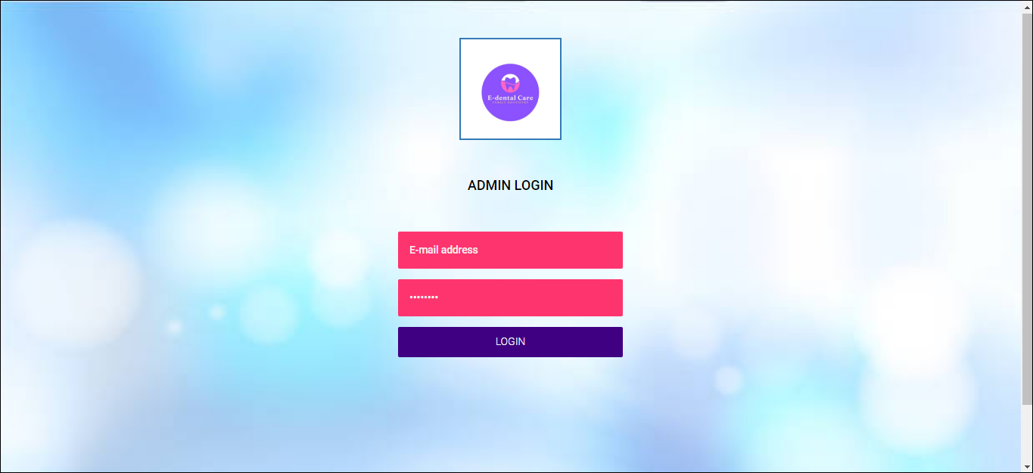
Implemented screenshot
ADMIN PANEL (INDEX.PHP):

Slide 5
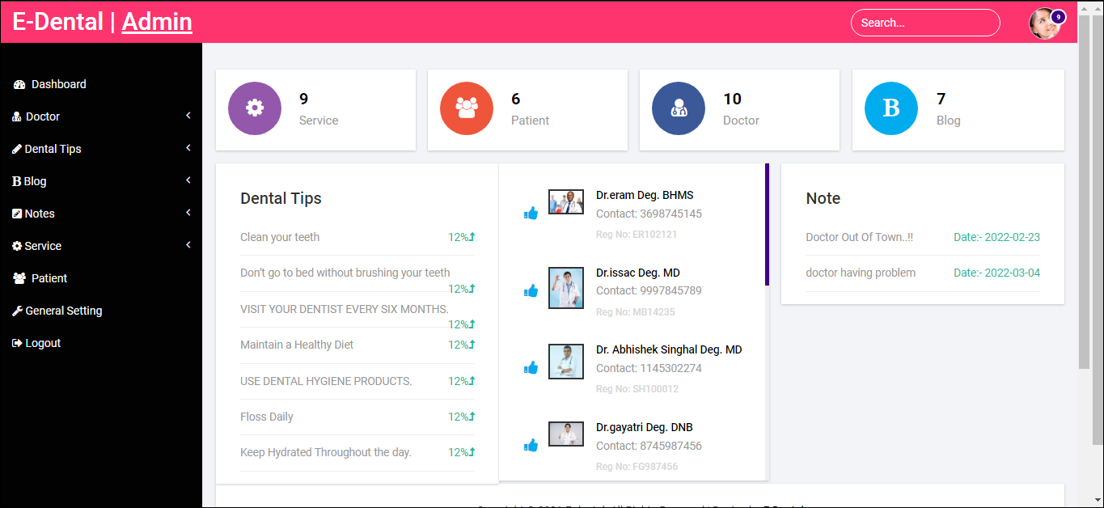
ADMIN PANEL (DASHBOARD.PHP):

Slide 6
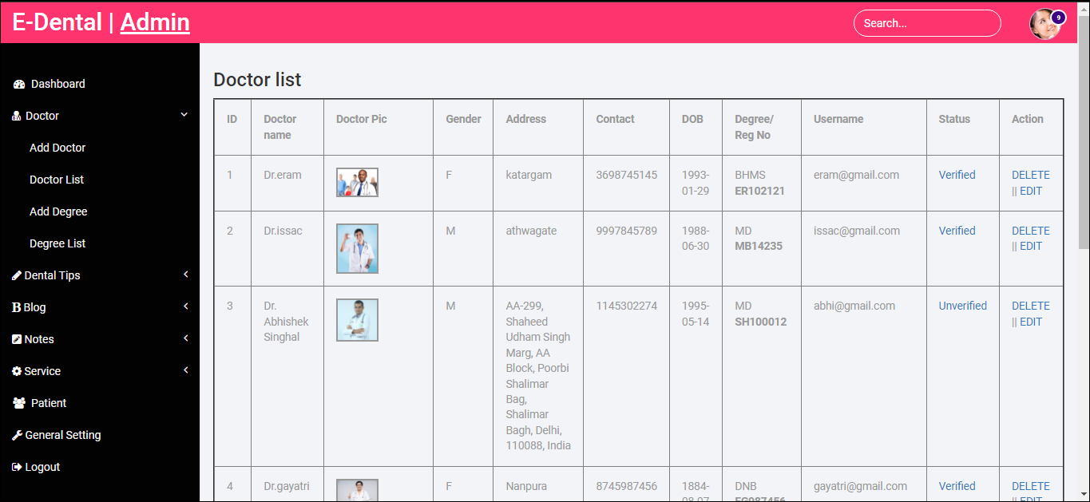
ADMIN PANEL (DOCTOR_LIST.PHP):

Slide 7
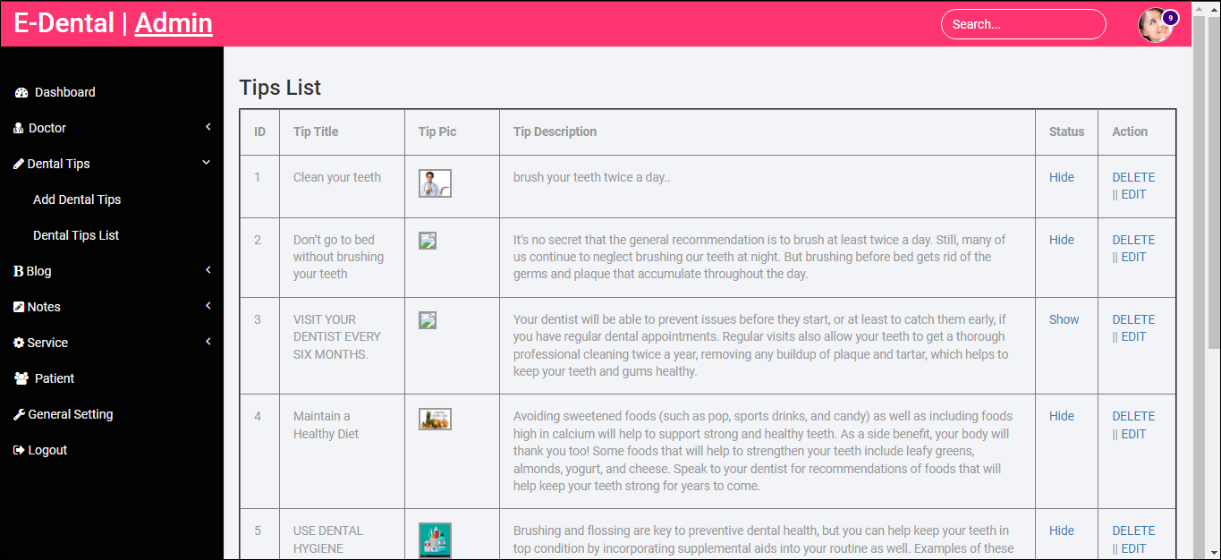
ADMIN PANEL (DENTIST_TIPS.PHP):

Slide 8

DOCTOR PANEL (INDEX.PHP):

Slide 9

DOCTOR PANEL (DASHBOARD.PHP):

Slide 10
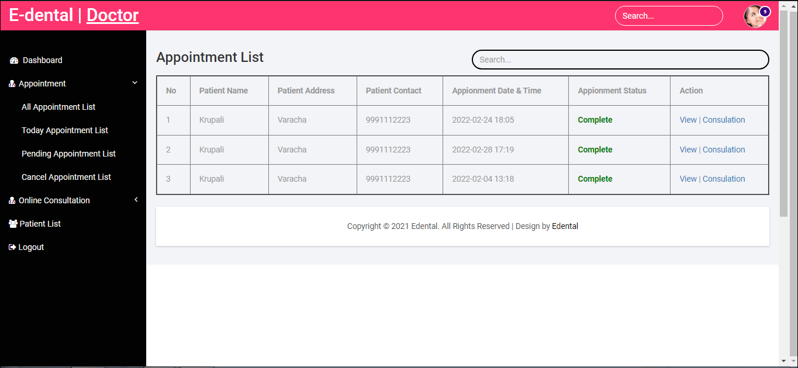
DOCTOR PANEL (APPOINTMENT_LIST.PHP):

Slide 11
Companies visited
Company visited
1. Hunani InfoTech
2. NSB IT solution
3. Narola infotech
4. Netsol IT solutions Pvt. Ltd.
5. Uniqual iTech

Slide 12
Thank you.

